Slide 1

计算机组成与系统结构 Computer Organization & System Architecture
Huang Kejie (黄科杰) 百人计划研究员
Office: 玉泉校区老生仪楼304
Email address: huangkejie@zju.edu.cn
HP: 17706443800

Slide 2

About
Grading
Attendance 5%
Project 40%
Homework 5%
Mid-term exam 15%
Final exam 35%
Bonus 5%
Textbooks/Materials
Computer Organization and Design RISC-V Edition, Patterson and Hennessy's ("P&H"), ISBN 0128122757.
TAs

Slide 3
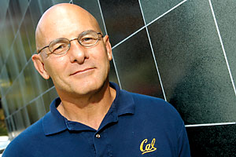
David A. Patterson (UC Berkeley）
Born in Nov 16, 1947
Married in 1967, have 4 children
Leading the Berkeley RISC project (the foundation of the SPARC architecture )
Leading the research on RAID storage
Vice Chair of the Board of Directors of the RISC-V Foundation
Pardee Professor of Computer Science, Emeritus at UC Berkeley
Received Eckert-Mauchly Award in 2008
Won the 2017 Turing Award with Hennessy

Slide 4
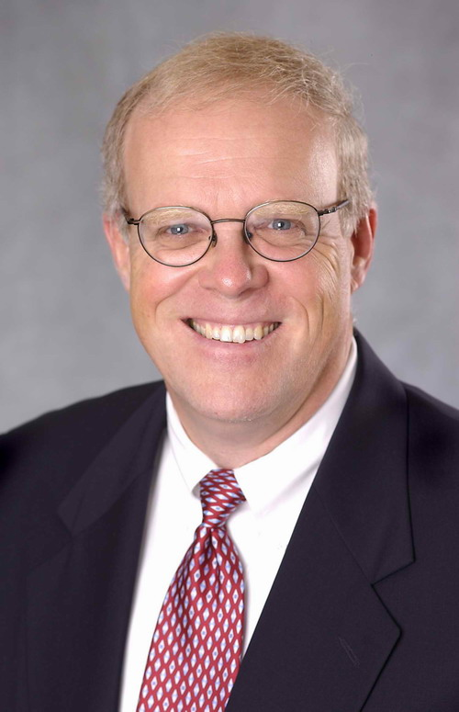
John L. Hennessy (Stanford)
The 10th President of Stanford University
Initiated the RISC project at Stanford in 1981
Cofounded MIPS Computer Systems in 1984
Received Eckert-Mauchly Award in 2001
IEEE Medal of Honor
Won the 2017 Turing Award with Patterson
Marc Andreessen called him "the godfather of Silicon Valley."
2017年 浙大海外名师大讲堂

Slide 5
Acknowledgement
Most slides were adapted from lectures notes of the two textbooks with copyright of publisher or the original authors including Elsevier Inc, Morgan Kaufmann, David A. Patterson and John L. Hennessy.
Some slides were adapted from the following courses:
CS61C Great Ideas in Computer Architecture (Machine Structures), UC Berkeley EECS, Fall 2018
Computer Science 152/252: CS152 Computer Architecture and Engineering, CS252 Graduate Computer Architecture, Berkeley EECS, Spring 2018
CS/ECE 3810 Computer Organization, UTAH CS, Spring 2018
CSE 564: Computer Architecture, Oakland University, Summer 2017
18-447 Introduction to Computer Architecture, CMU ECE, Spring 2018
15-213/18-213/15-513: Intro to Computer Systems, CMU CS, Fall 2018
ECE 120 - Introduction to Computing, ILLINOIS, ECE, Spring 2017
CS - Computer Organization & Design The Hardware/Software Interface, ZJU CS, Spring 2018

Slide 6
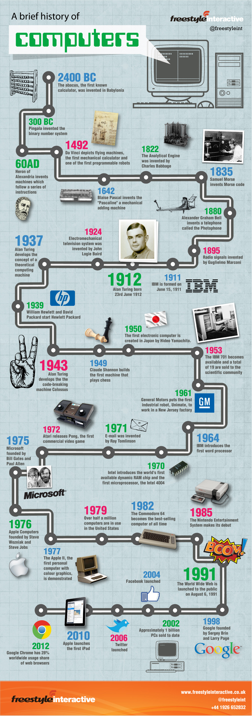
A Brief History of Computer

Slide 7
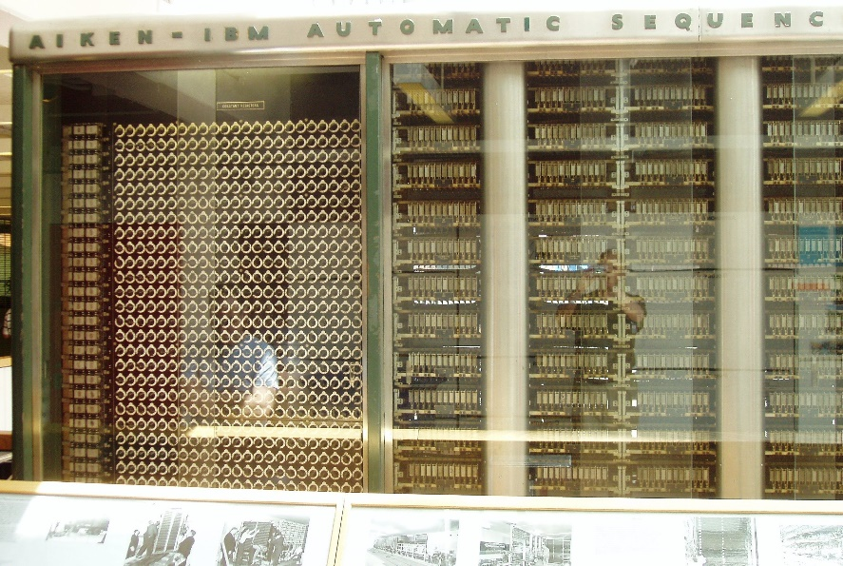
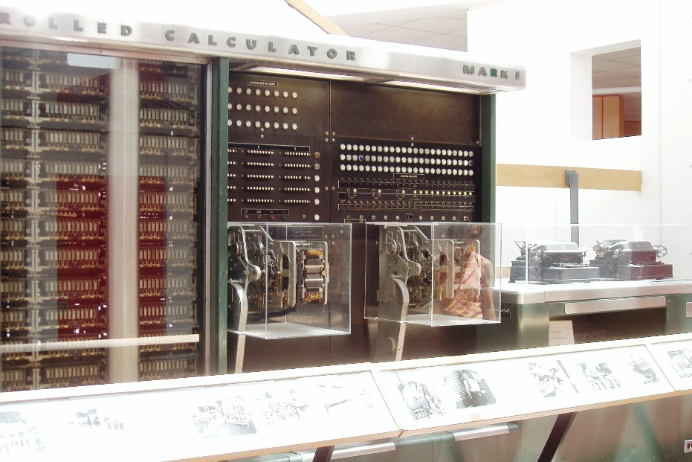
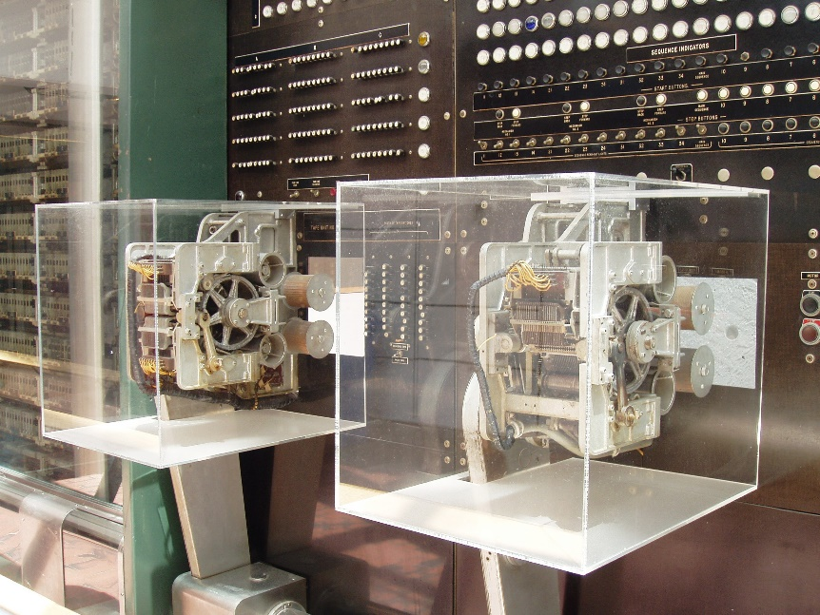
Mark I (Harvard) – IBM (ASCC) Automatic Sequence Controlled Calculator
“the beginning of the era of the modern computer” and "the real dawn of the computer age”.

Slide 8
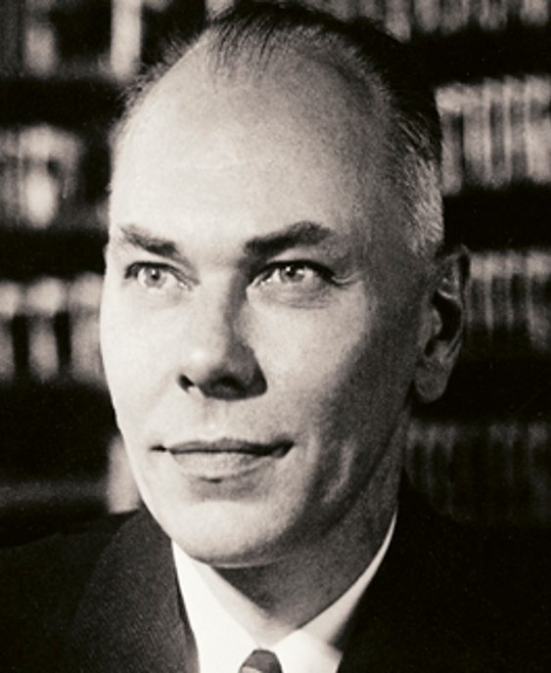
Mark I (Harvard) ASCC (IBM)
765,000 components and 500 miles (800 km) of wire with three million connections
Volume of 51 feet (16 m) in length, eight feet (2.4 m) in height, and two feet (~61 cm) deep.
Weight of about 10,000 pounds (4500 kg).
The basic calculating units had to be synchronized mechanically, so they were run by a 50-foot (~15.5 m) shaft driven by a five-horsepower (4 kW) electric motor
The industry's largest electromechanical calculator

Slide 9
Generations of Computer
Generation 1: 1946-1957
Vacuum tube
Generation 2: 1958-1964
Transistor -
Generation 3: 1965-1970
Small scale integration, Up to 100 devices on a chip
Medium scale integration , 100-3,000 devices on a chip
Generation 4: 1971-
Large scale integration , 3000 - 100000 devices on a chip
Very large scale integration , 100,000 - 100,000,000 devices on a chip, 1978-
Ultra large scale integration, Over 100,000,000 devices on a chip

Slide 10
Electronic Computers -- Generation 1
Dominant technologies:
Processors: Vacuum tubes
Memory: Acoustic delay line, magnetic drum
Special-purpose system
John Atanasoff’s experimental machine
Colossus , ( decrypt the German Enigma cipher)
Hoffman’s computer (decrypt the Japanese Enigma cipher)
Programmable systems
ENIAC I-IV
Store-program systems
Experimental projects: EDVAC,
Commercial products: UNIVAC I, IBM701, 704(fp hardware)

Slide 11
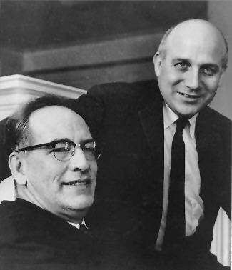
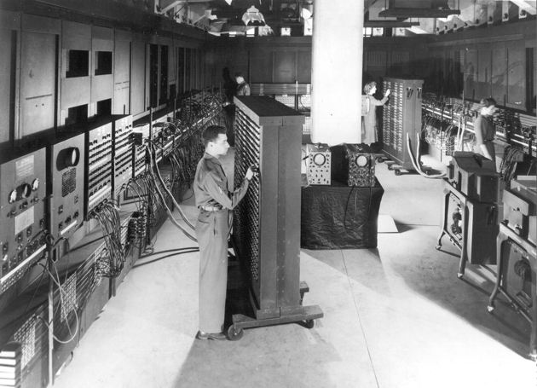
ENIAC-I 1st electronic general-purpose computer
Electronic Numerical Integrator And Computer
J. Presper Eckert and John Mauchly
University of Pennsylvania
Trajectory tables for weapons
Started 1943, Finished 1946, Used until 1955
ENIAC-I details
Decimal (not binary)
20 accumulators of 10 digits
Programmed manually by switches
18,000 vacuum tubes
30 tons
15,000 square feet
140 kW power consumption
5,000 additions per second

Slide 12
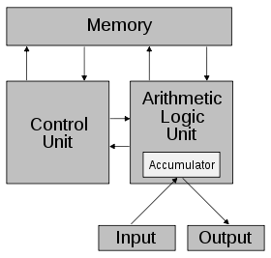


Von Neumann/Turing
"universal computing machine”, 1936, Alan Turing
EDVAC 1944 (Eckert and Mauchly)
First Draft of a Report on the EDVAC 1945, Von Neumann
Stored Program concept
Main memory storing programs and data
ALU operating on binary data
Control unit interpreting instructions from memory and executing
Input and output equipment operated by control unit

Slide 13
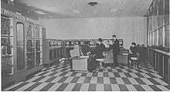
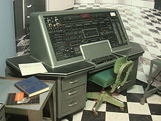
1st Commercial Computers
1947 - Eckert-Mauchly Computer Corporation
UNIVAC I (Universal Automatic Computer)
US Bureau of Census 1950 calculations
Became part of Sperry-Rand Corporation
Late 1950s - UNIVAC II
Faster
More memory

Slide 14
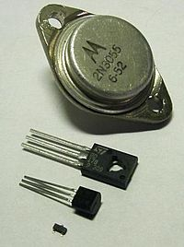
Electronic Computers -- Generation 2
Dominant technologies
Processors: Discrete transistors
Replaced vacuum tubes
Smaller & Cheaper
Less heat dissipation
Solid State device
Made from Silicon (Sand)
Invented 1947 at Bell Labs
William Shockley et al.
Memory: Magnetic cores
General-purpose computers
IBM System/360
Minicomputers: Digital Equipment PDP-8
Supercomputers
Control Data 6600
Innovations: Load-store architecture, pipeline
Assorted discrete transistors.
TO-3, TO-126, TO-92, SOT-23

Slide 15
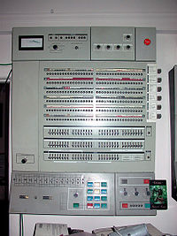
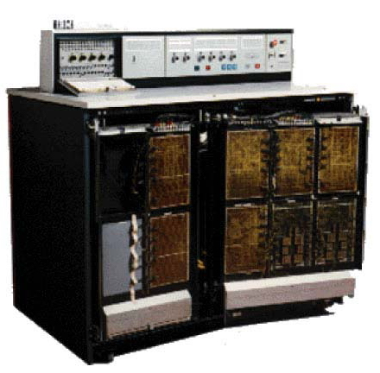
IBM 360 series
1964
Replaced (& not compatible with) 7000 series
First planned “family” of computers
Similar or identical instruction sets
Similar or identical O/S
Increasing speed
Increasing number of I/O ports (i.e. more terminals)
Increased memory size
Increased cost
Multiplexed switch structure

Slide 16
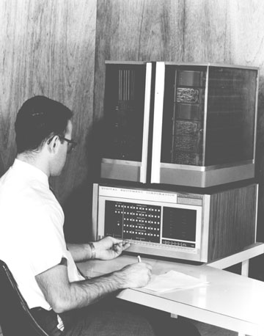
DEC PDP-8
1964
First minicomputer (after miniskirt!)
Did not need air conditioned room
Small enough to sit on a lab bench
$16,000
$100k+ for IBM 360
Embedded applications & OEM
BUS STRUCTURE

Slide 17
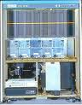
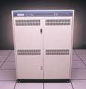
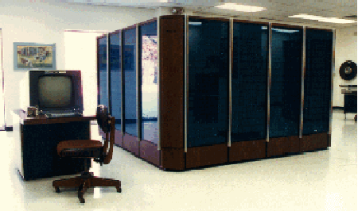
Electronic Computers -- Generation 3
Dominant technologies:
Processors: Integrated circuits
Memory:
Early: Magnetic cores
Later: Integrated circuits(SRAM, DRAM)
General-purpose computers
Minicomputers: PDP-11, VAX11-780
IBM system/370
Supercomputer s
Control Data 7600
Cray-1

Slide 18
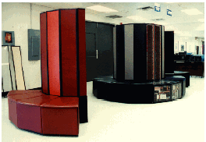
Electronic Computers -- Generation 4
Dominant technologies
Processors: Custom LSI or VLSI modules on PC board
Memory: SRAM, DRAM
General-purpose computers
IBM 3xxx, 43xx series
Minicomputers: VAX8400
Mini-supercomputers:
Convex C-1, C-2, C-3
Vector supercomputers
Cray-2, Cray X-MP, Cray Y-MP
Fujitsu, Hitachi, NEC

Slide 19
Electronic Computers -- Generation 4
Dominant technologies
Processors: Mass-produced microprocessors
Memory: SRAM, DRAM
Compilers
RISC processors
RISC-V
MIPS (Silicon Graphics)
PA-RISC (Hewlett Packard)
SPARC ( Sun Microsystems)
Alpha ( Digital Equipment)
PowerPC( Apple, Motorala, IBM)
Motorala 88000
I860, i960 (Intel)
CISC processors:
80x86, Pentium, Penium Pro, Pentium II & III (Intel)

Slide 20

Cloud Computing

Slide 21

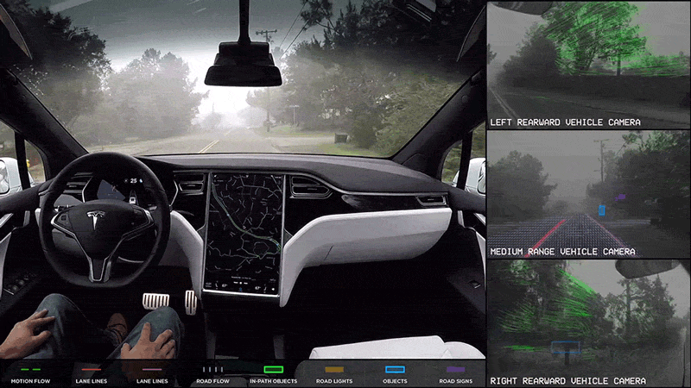
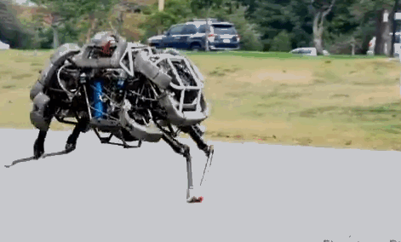

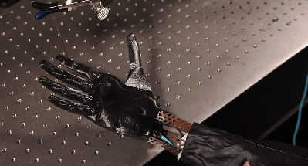
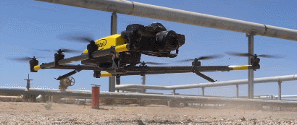

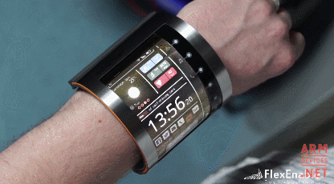
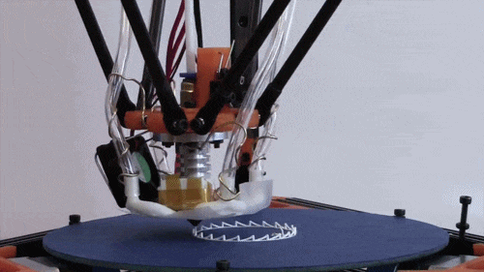
Ubiquitous/AI Computers -- Generation 5

Slide 22
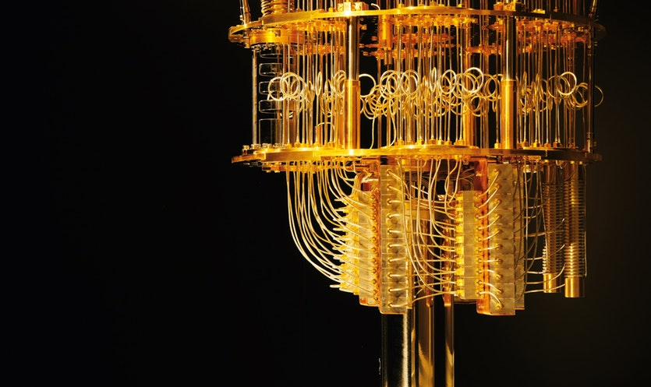
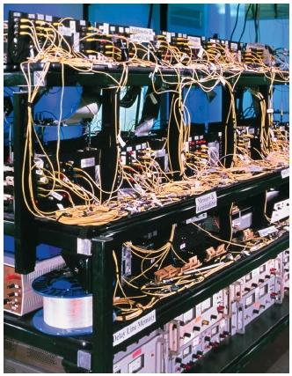
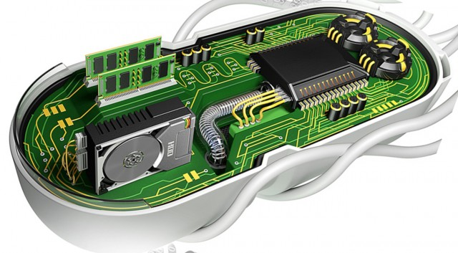
Future Computers
Quantum Computer
Optical Computer
https://cosmosmagazine.com/technology/hello-quantum-world
Biological Computer
https://thecustomizewindows.com/2013/02/optical-computing-or-photonic-computing/
https://www.extremetech.com/extreme/232190-how-mits-new-biological-computer-works-and-what-it-could-do-in-the-future

Slide 23
Why Computer Organization
Embarrassing if you are a BS in CS/CE and can’t
make sense of the following terms: DRAM, pipelining,
cache hierarchies, I/O, virtual memory, …
Embarrassing if you are a BS in CS/CE and can’t decide
which processor to buy: 3 GHz Xeon or 2.5 GHz Athlon
(helps us reason about performance/power), …
Obvious first step for chip designers, compiler/OS writers
Will knowledge of the hardware help you write better
and more secure programs?

Slide 24
Computer Components
Primary storage: volatile, faster, costlier
Secondary storage: non-volatile, slower, cheaper
CPU/processor (datapath and control)
Input/output devices

Slide 25
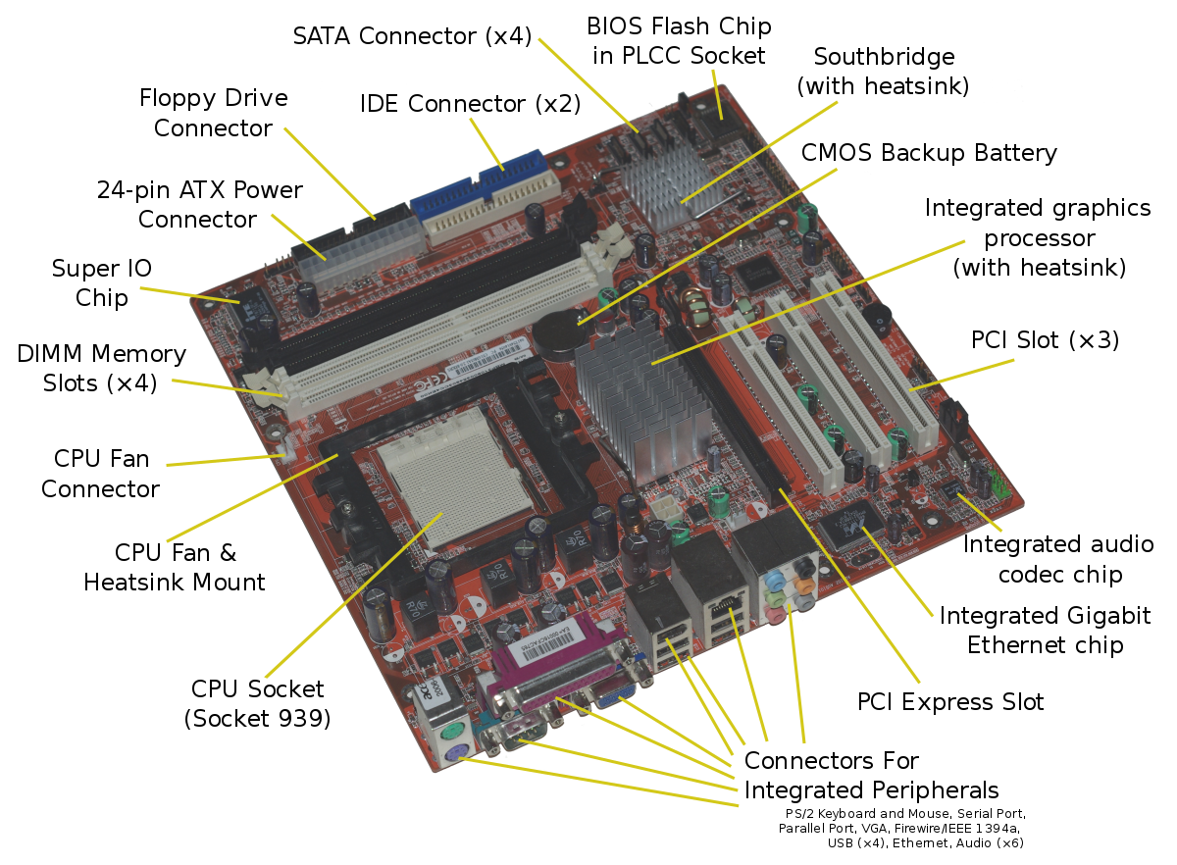
Motherboard

Slide 26
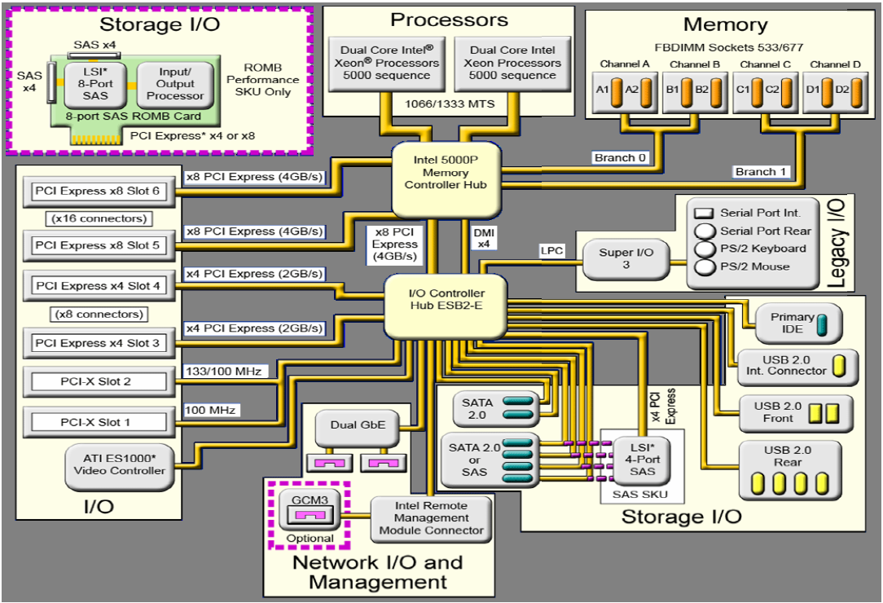
Intel ATX Motherboard Diagram

Slide 27
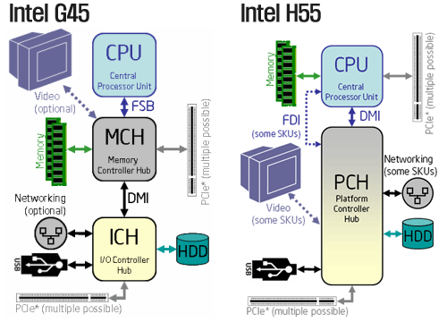
2009 ME Repartition
2006-2008
2009

Slide 28
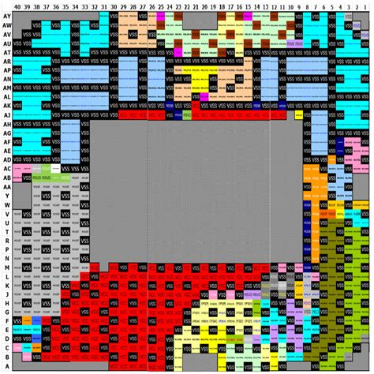
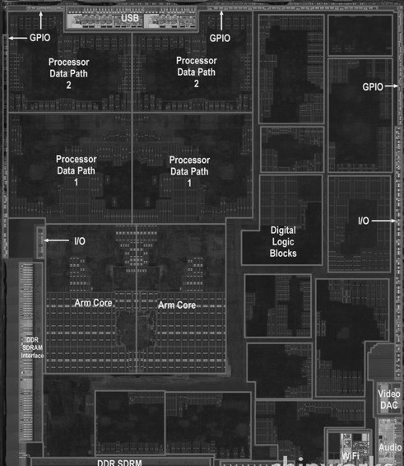
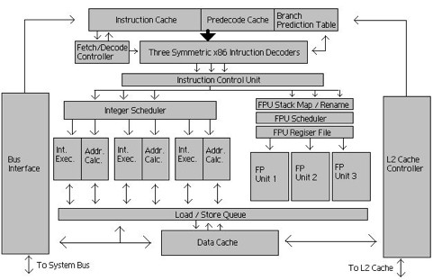
Processor (CPU) Zoom in
Functional units: performs computations
Datapath: performs operations on data
Control: sequences datapath, memory, ...
Cache memory
Small fast SRAM memory for immediate access to data
Apple A5

Slide 29
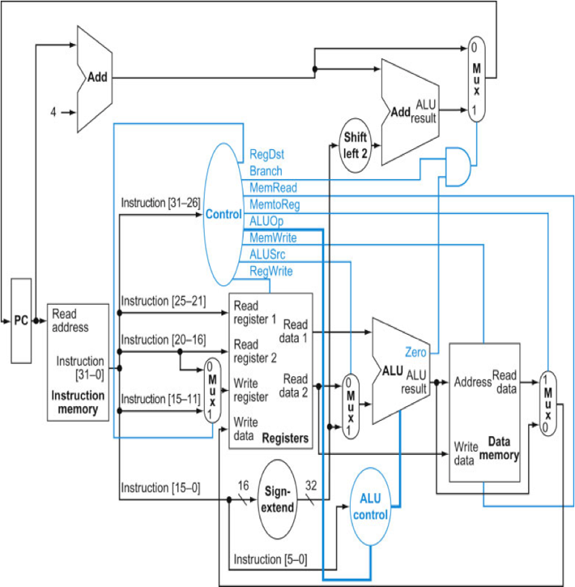
Computer Architecture
How things are put together in design and implementation
Capabilities & Performance Characteristics of Principal Functional Units
(e.g., Registers, ALU, Shifters, Logic Units, ...)
Ways in which these components are interconnected
Information ﬂows between components
Logic and means control unit
Choreography of FUs to realize the ISA

Slide 30
Elements of an ISA
Set of machine-recognized data types
bytes, words, integers, floating point, strings, . . .
Operations performed on those data types
Add, sub, mul, div, xor, move, ….
Programmable storage
regs, PC, memory
Methods of identifying and obtaining data referenced by instructions (addressing modes)
Literal, reg., absolute, relative, reg + offset, …
Format (encoding) of the instructions
Op code, operand fields, …

Slide 31
Deﬁning Computer Architecture
“Old” view of computer architecture:
Instruction Set Architecture (ISA) design
i.e. decisions regarding:
registers, memory addressing, addressing modes, instruction operands, available operations, control ﬂow instructions, instruction encoding
“Real” computer architecture:
Speciﬁc requirements of the target machine
Design to maximize performance within constraints: cost, power, and availability
Includes ISA, microarchitecture, hardware

Slide 32








Great Ideas in Computer Architectures
Design for Moore’s Law
Use abstraction to simplify design
Make the common case fast
Performance via parallelism
Performance via pipelining
Performance via prediction
Hierarchy of memories
Dependability via redundancy

Slide 33
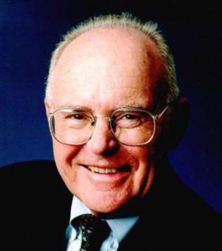
Great Idea: “Moore’s Law”
Gordon Moore - cofounder of Intel
Increased density of components on chip
1965: Number of transistors on a chip will double every year
Since 1970’s development has slowed a little
Number of transistors doubles every 18 months
Cost of a chip has remained almost unchanged
Higher packing density means shorter electrical paths, giving higher performance
Smaller size gives increased flexibility
Reduced power and cooling requirements
Fewer interconnections increases reliability

Slide 34
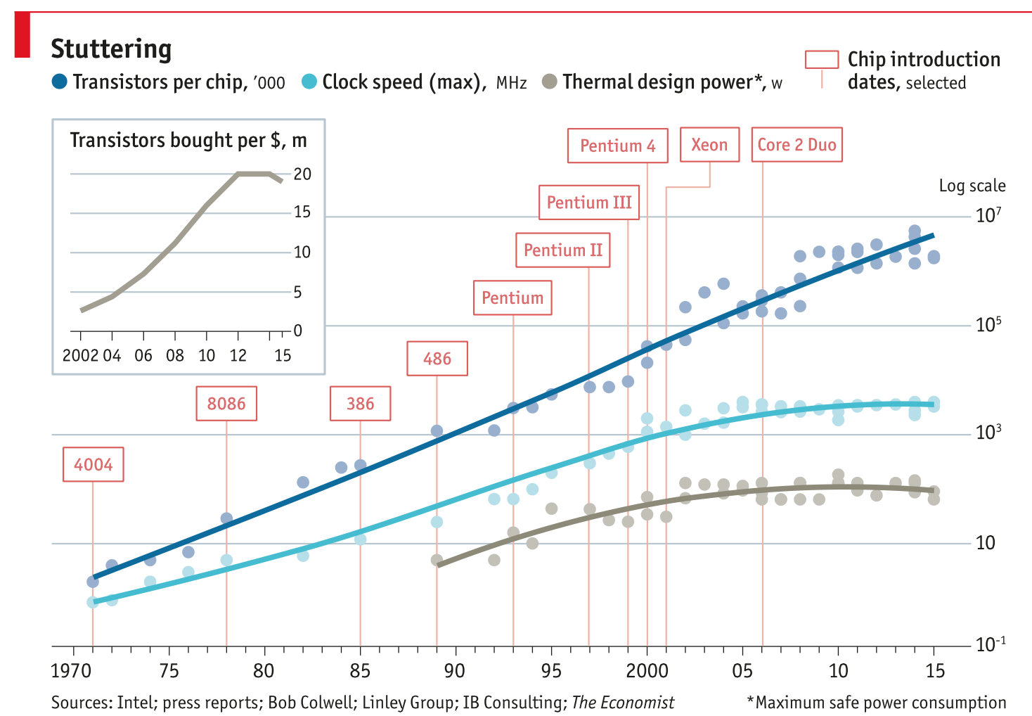
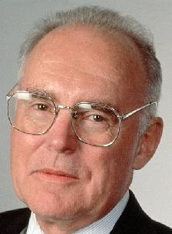
Moore’s Law
Predicts: 2X Transistors / chip every 2 years
CPU Speed Flat
CPU Clock Speed +15%/year
Gordon Moore Intel Cofounder B.S. Cal 1950!

Slide 35
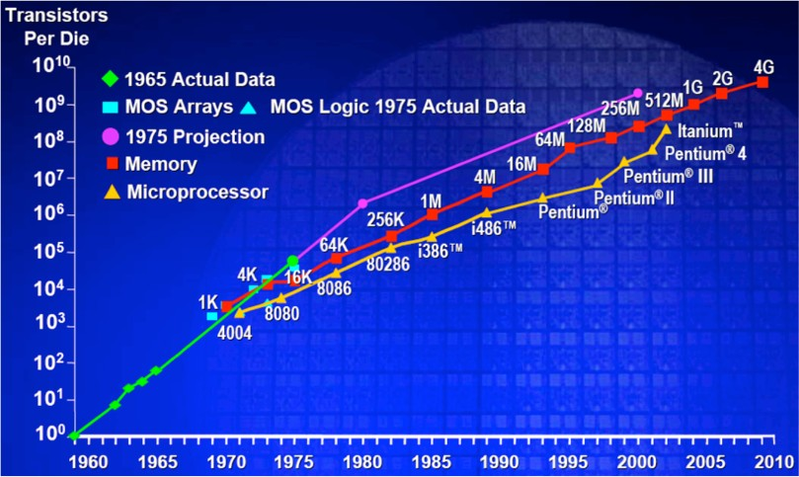
Microprocessor Transistor Counts

Slide 36
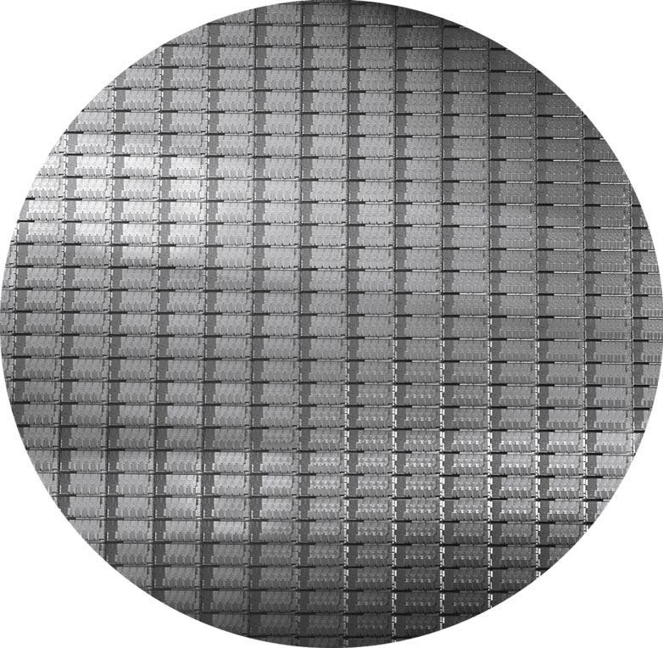
Wafers and Dies
Source: H&P Textbook

Slide 37
Manufacturing Process
Silicon wafers undergo many processing steps so that
different parts of the wafer behave as insulators,
conductors, and transistors (switches)
Multiple metal layers on the silicon enable connections
between transistors
The wafer is chopped into many dies – the size of the die
determines yield and cost

Slide 38
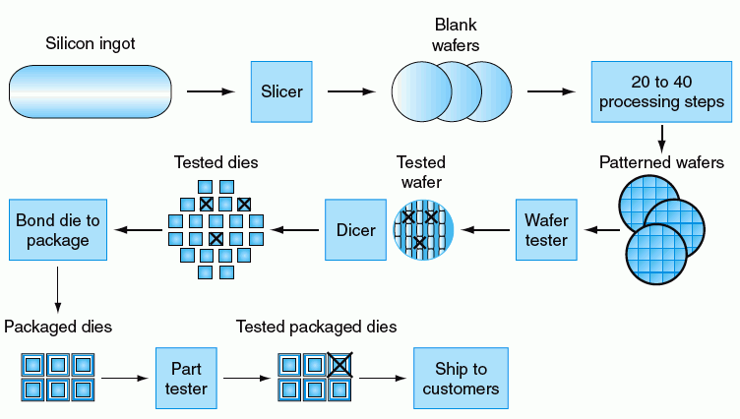
Technologies for Building Processors and Memory

Slide 39
IC Technique Evolution
1962, SSI (Small-Scale Integration) 12 transistors
1966, MSI (Medium-Scale Integration),100－1k transistors
1967－1973， LSI (Large-Scale Integration)，1k~100k transistors
1977，VLSI (Very Large-Scale Integration)，30m², 150k transistors
1993, ULSI (Ultra Large-Scale Integration) 16M FLASH and 256M DRAM which integrate 10M transistors
1994， GSI (Giga Scale Integration) 1G DRAM which integrate 100M transistors
2007: 2T flops 80core CPU

Slide 40
Processor Technology Trends
Shrinking of transistor sizes: 250nm (1997) →
130nm (2002) → 70nm (2008) → 35nm (2014)
Transistor density increases by 35% per year and die size
increases by 10-20% per year… functionality improvements!
Transistor speed improves linearly with size (complex
equation involving voltages, resistances, capacitances)
Wire delays do not scale down at the same rate as
transistor delays

Slide 41
Moore’s Law trends
Several interacting dimensions
cache size
block size
associativity
replacement policy
write-through vs write-back
The optimal choice is a compromise
depends on access characteristics
workload
use (I-cache, D-cache, TLB)
depends on technology / cost
Simplicity often wins
Cache Size
Associativity
Block Size
Bad
Good
Factor A
Factor B
Less
More

Slide 42
Moore’s Law trends
More transistors = ↑ opportunities for exploiting parallelism in the instruction level (ILP)
Pipeline, superscalar, VLIW (Very Long Instruction Word), SIMD (Single Instruction Multiple Data) or vector, speculation, branch prediction
General path of scaling
Wider instruction issue, longer pipeline
More speculation
More and larger registers and cache
Increasing circuit density ~= increasing frequency ~= increasing performance
Transparent to users
An easy job of getting better performance: buying faster processors (higher frequency)
We have enjoyed this free lunch for several decades, however …

Slide 43
Important Trends
Historical contributions to performance:
Better processes (faster devices) ~20%
Better circuits/pipelines ~15%
Better organization/architecture ~15%
In the future, bullet-2 will help little and bullet-1 will
eventually disappear!
Pentium P-Pro P-II P-III P-4 Itanium Montecito
Year 1993 95 97 99 2000 2002 2005
Transistors 3.1M 5.5M 7.5M 9.5M 42M 300M 1720M
Clock Speed 60M 200M 300M 500M 1500M 800M 1800M
Moore’s Law in action
At this point, adding transistors
to a core yields little benefit

Slide 44
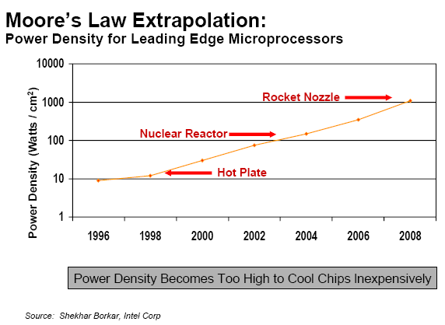
Power/heat Density Limits Frequency
Some fundamental physical limits are being reached

Slide 45
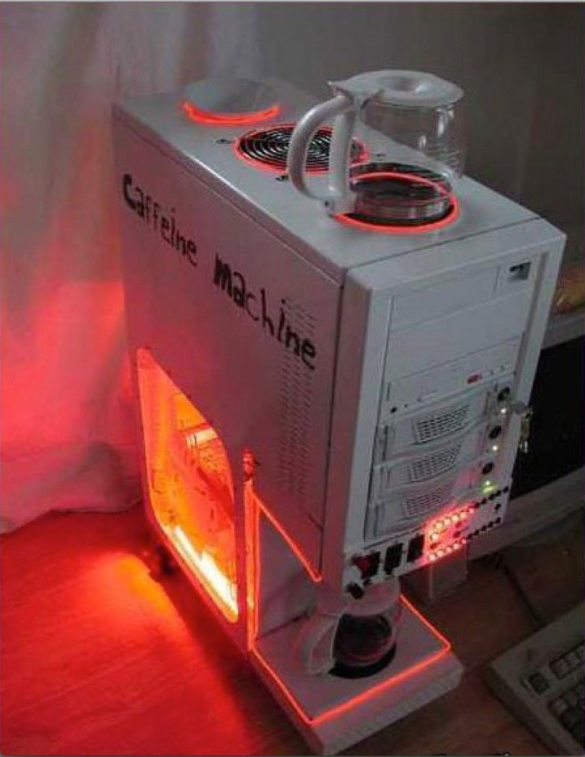
We will have this …

Slide 46
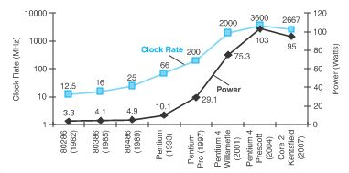
Power Wall
Dyn power = activity x capacitance x voltage2 x frequency
Power efficiency decrease
the trend of consuming double the power with each doubling of operating frequency
Hot-spot
Voltage and frequency are constant
Capacitance per transistor is decreasing
Number of transistors (activity) is increasing
Leakage power is also rising

Slide 47
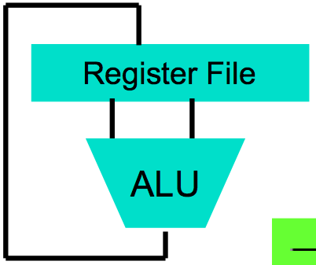
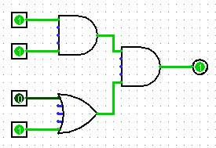
Abstraction (Levels of Representation/Interpretation)
human language / theory
Tasks
Algorithms
High Level Language Program (e.g., C)
temp = v[k];
v[k] = v[k+1];
v[k+1] = temp;
Compiler
Anything can be represented as a number, i.e., data or instructions
software
Assembly Language Program (e.g., RISCV)
lw $t0, 0($2)
lw $t1, 4($2)
sw $t1, 0($2)
sw $t0, 4($2)
Assembler
0000 1001 1100 0110 1010 1111 0101 1000
1010 1111 0101 1000 0000 1001 1100 0110
1100 0110 1010 1111 0101 1000 0000 1001
0101 1000 0000 1001 1100 0110 1010 1111
Machine Language Program (RISCV)
digital hardware
Machine Interpretation
Hardware Architecture Description (e.g., block diagrams)
Architecture Implementation
Logic Circuit Description (Circuit Schematic Diagrams)
Devices

Slide 48
The HW/SW Interface
Application software
a[i] = b[i] + c;
Compiler
lw $15, 0($2)
add $16, $15, $14
add $17, $15, $13
lw $18, 0($12)
lw $19, 0($17)
add $20, $18, $19
sw $20, 0($16)
Systems software
(OS, compiler)
Assembler
Hardware
000000101100000
110100000100010
…

Slide 49
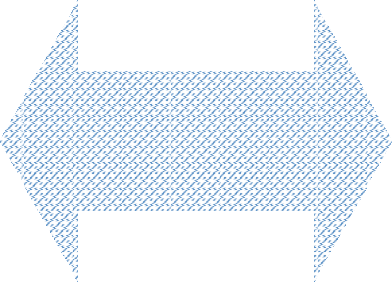
Computer Architecture Topics
Input/Output and Storage
Disks, WORM, Tape
RAID
DRAM
Emerging Technologies Interleaving
Bus protocols
Memory Hierarchy
L2/L3 Cache
Coherence, Bandwidth, Latency
Other Processors
Network Communication
L1 Cache
Addressing,
VLSI
Protection, Exception Handling
Pipelining and Instruction Level Parallelism
Instruction Set Architecture
Pipelining, Hazard Resolution, Superscalar, Reordering, Prediction, Speculation, Vector, Dynamic Compilation

Slide 50
The Memory Abstraction
Association of <name, value> pairs
typically named as byte addresses
often values aligned on multiples of size
Sequence of Reads and Writes
Write binds a value to an address
Read of addr returns most recently written value bound to that address
command (R/W)
address (name)
data (W)
data (R)
done

Slide 51
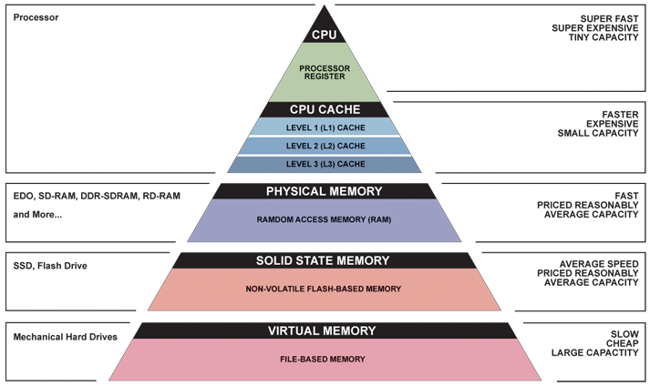
Memory Hierarchy

Slide 52
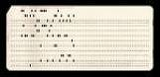

Early Memory Technology
Babbage, 1800s: Digits stored on mechanical wheels
Punched cards, From early 1700s through Jaquard Loom, Babbage, and then IBM

Slide 53



Early Memory Technology
Mercury Delay Line, Univac 1, 1951
Punched paper tape, instruction stream in Harvard Mk 1
Williams Tube, Manchester Mark 1, 1947

Slide 54


MIT Whirlwind Core Memory

Slide 55



Modern DRAM Technology
46nm DDR2 DRAM [© Chipworks]

Slide 56
Memory and I/O Technology Trends
DRAM density increases by 40-60% per year, latency has
reduced by 33% in 10 years (the memory wall!), bandwidth
improves twice as fast as latency decreases
Disk density improves by 100% every year, latency
improvement similar to DRAM
Networks: primary focus on bandwidth; 10Mb → 100Mb
in 10 years; 100Mb → 1Gb in 5 years

Slide 57

Jim Gray’s Storage Latency Analogy: How Far Away is the Data?
Andromeda
10
9
Tape /Optical
2,000 Years
Robot
10
6
Disk
Pluto
2 Years
Shanghai
1.5 hr
100
Main Memory
Jim Gray Turing Award
B.S. Cal 1966
Ph.D. Cal 1969!
10
On Board Cache
This Campus
10 min
2
On Chip Cache
This Room
1
Registers
My Head
1 min
(ns)

Slide 58
Memory Wall
µProc
52%/yr.
µProc
20%/yr.
CPU
L2 cache is getting larger with less performance contribution
“Moore’s Law”
Processor-Memory
Performance Gap: (grows 50% / year)
µProc
25%/yr.
“Less’ Law?”
DRAM
7%/yr.
DRAM
1980: no cache in µproc; 2001: 2-level cache on chip (1989 first Intel µproc with a cache on chip)

Slide 59
The Principle of Locality
The Principle of Locality:
Program access a relatively small portion of the address space at any instant of time.
Two Diﬀerent Types of Locality:
Temporal Locality (Locality in Time): If an item is referenced, it will tend to be referenced again soon (e.g., loops, reuse)
Spatial Locality (Locality in Space): If an item is referenced, items whose addresses are close by tend to be referenced soon (e.g., straight-line code, array access)
Last 30 years, HW relied on locality for speed
MEM
P
$

Slide 60
Must a Programmer Care About Hardware?
Must know how to reason about program performance
and energy and security
Memory management: if we understand how/where data
is placed, we can help ensure that relevant data is nearby
Thread management: if we understand how threads
interact, we can write smarter multi-threaded programs
→ Why do we care about multi-threaded programs?
Multithreading aims to increase utilization of a single core by using thread-level parallelism, as well as instruction-level parallelism

Slide 61
ILP Wall
“ILP wall” refers to increasing difficulty to find enough parallelism in the instructions stream of a single process to keep higher performance processor cores busy.
20%: little ILP left to exploit due to power dissipation and memory gap
Faster uniprocessor => multiple processor on chip
ILP => TLP and DLP
Implicit, compiler and hardware => Explicit, programmer

Slide 62




New-School Machine Structures
Software Hardware
Parallel Requests
Assigned to computer
e.g., Search “cats”
Parallel Threads
Assigned to core
e.g., Lookup, Ads
Parallel Instructions
>1 instruction @ one time
e.g., 5 pipelined instructions
Parallel Data
>1 data item @ one time
e.g., Add of 4 pairs of words
Hardware descriptions
All gates functioning in parallel at same time
Warehouse-Scale Computer
Smart Phone
Harness Parallelism &
Achieve High Performance
Computer
Core
…
Core
Memory (Cache)
Input/Output
Core
Instruction Unit(s)
Functional
Unit(s)
A₀+B₀
A₁+B₁
A₂+B₂
A₃+B₃
Main Memory
Logic Gates
62

Slide 63
Parallelism
Classes of parallelism in applications:
Data-Level Parallelism (DLP)
Distribute data over different computing environments
Task-Level Parallelism (TLP)
Distribute threads across different computing environments
Classes of architectural parallelism:
Bit level parallelism
Increase processor word size
Instruction-Level Parallelism (ILP)
Instructions combined into groups
Thread-Level Parallelism
The use of multiple threads of execution that are inherently parallel
Vector architectures/Graphic Processor Units (GPUs)
Heterogeneity

Slide 64


Parallelism

Slide 65

Flynn’s Taxonomy

Slide 66



















Recent manycore GPU processors
~3k cores
SMX: 192 single precision CUDA cores, 64 double precision units, 32 special function units (SFU), and 32 load/store units (LD/ST).

Slide 67
Example
200x speedup for matrix vector multiplication
Data level parallelism: 3.8x
Loop unrolling and out-of-order execution: 2.3x
Cache blocking: 2.5x
Thread level parallelism: 14x
Further, can use accelerators to get an additional 100x.

Slide 68
Great Idea: Pipeline
Fundamental Execution Cycle
Obtain instruction from program storage
Memory
Instruction
Fetch
program
Data
Processor
Instruction
Decode
Determine required accons and instruction size
Locate and obtain operand data
regs
F.U.s
Operand
Fetch
Execute
Compute result value or status
Deposit results in storage for later use
von Neumann bottleneck
Result
Store
Next
Instruction
Determine successor instruction

Slide 69
Pipelined Instruction Execution
Time (clock cycles)
Cycle 1 Cycle 2 Cycle 3 Cycle 4 Cycle 5 Cycle 6 Cycle 7
I
n s t
r.
O
r d e r
Ifetch Reg DMem
ALU
Reg
Ifetch
Reg
ALU
DMem
Reg
Ifetch
Reg
ALU
DMem
Reg
Ifetch
Reg
ALU
DMem
Reg

Slide 70
Dependability via Redundancy
Redundancy so that a failing piece doesn’t make the whole system fail
1+1=2
2 of 3 agree
1+1=2
1+1=2
1+1=1
FAIL!
Increasing transistor density reduces the cost of redundancy

Slide 71


Dependability via Redundancy
Applies to everything from datacenters to storage to memory to instructors
Redundant datacenters so that can lose 1 datacenter but Internet service stays online
Redundant disks so that can lose 1 disk but not lose data (Redundant Arrays of Independent Disks/RAID)
Redundant memory bits of so that can lose 1 bit but no data (Error Correcting Code/ECC Memory)

Slide 72


New Conventional Wisdom
Google TPU2
Specialized Engine for NN training
Deployed in cloud
45 TFLOPS/chip
Serious heatsinks!

Slide 73
Performance Metrics
Possible measures:
response time – time elapsed between start and end
of a program
throughput – amount of work done in a fixed time
The two measures are usually linked
A faster processor will improve both
More processors will likely only improve throughput
Some policies will improve throughput and worsen
response time
What influences performance?

Slide 74
CPU time—CPU performance
CPU time is further divided into:
User time - time spent in user mode
System time - time spent in the operating system (OS)
Unix time command reports CPU time as:
90.7u 12.9s 2:39 65%
90.7 user CPU seconds (in the user’s program)
12.9 system CPU seconds (in the system calls e.g. printf)
2 minutes, 39 seconds wall-clock time
65% of the wall clock time was spent running on the CPU

Slide 75
Factors Influencing Performance
Execution time = clock cycle time x number of instrs x avg CPI
Clock cycle time: manufacturing process (how fast is each
transistor), how much work gets done in each pipeline stage
(more on this later)
Number of instrs: the quality of the compiler and the
instruction set architecture
CPI: the nature of each instruction and the quality of the
architecture implementation

Slide 76
Iron Law—CPU performance
CPU time = Instructions * CPI * Clock cycle time
= Instructions * CPI / Clock rate
= Instructions / MIPS
Architecture --> Implementation --> Realization
Compiler Designer Processor Designer Chip Designer
Hardware / Software | Affects what ? | How?
Algorithm | IC, possibly CPI | Favoring instructions
Programming language | IC, CPI | Java : indirect calls
Compiler | IC, CPI
Instruction set Architecture | IC, CPI, CC
Organization | CPI, CC
IC | CC

Slide 77
Execution Time
Consider a system X executing a fixed workload W
Performance_{X} = 1 / Execution time_{X}
Execution time = response time = wall clock time
- Note that this includes time to execute the workload
as well as time spent by the operating system
co-ordinating various events
The UNIX “time” command breaks up the wall clock time
as user and system time

Slide 78


Compare Performance
“Performance of P1 is better than P2 ” is, for a given work load L, P1 takes less time to execute L than P2 does
performance(P1) > Performance(P2)
→ Execution Time(P1, L) < Execution Time(P1, L)
“Processor X is n times fast than Y” is

Slide 79
Speedup and Improvement
System X executes a program in 10 seconds, system Y
executes the same program in 15 seconds
System X is 1.5 times faster than system Y
The speedup of system X over system Y is 1.5 (the ratio)
= perf X / perf Y = exectime Y / exectime X
The performance improvement of X over Y is
1.5 -1 = 0.5 = 50% = (perf X – perf Y) / perf Y = speedup - 1
The execution time reduction for system X, compared to
Y is (15-10) / 15 = 33%
The execution time increase for Y, compared to X is
(15-10) / 10 = 50%

Slide 80
Performance Equation - I
CPU execution time = CPU clock cycles x Clock cycle time
Clock cycle time = 1 / Clock speed
If a processor has a frequency of 3 GHz, the clock ticks
3 billion times in a second – as we’ll soon see, with each
clock tick, one or more/less instructions may complete
If a program runs for 10 seconds on a 3 GHz processor,
how many clock cycles did it run for?
If a program runs for 2 billion clock cycles on a 1.5 GHz
processor, what is the execution time in seconds?

Slide 81
Performance Equation - II
CPU clock cycles = number of instrs x avg clock cycles
per instruction (CPI)
Substituting in previous equation,
Execution time = clock cycle time x number of instrs x avg CPI
If a 2 GHz processor graduates an instruction every third cycle,
how many instructions are there in a program that runs for
10 seconds?

Slide 82

Pitfall
Using a subset of the performance equation as a performance metric.
Example
MIPS - Millions of Instructions per Second
Instruction count clock rate
MIPS = ------------------------------ = -------------------
Execution time x 10⁶ CPI x 10⁶

Slide 83

Pitfall on Performance
Expecting the improvement of one aspect of a computer to increase overall performance by an amount proportional to the size of the improvement.
Example

Slide 84
Example
Execution time = clock cycle time x number of instrs x avg CPI
Which of the following two systems is better?
A program is converted into 4 billion MIPS instructions by a
compiler; the MIPS processor is implemented such that
each instruction completes in an average of 1.5 cycles and
the clock speed is 1 GHz
The same program is converted into 2 billion x86 instructions;
the x86 processor is implemented such that each instruction
completes in an average of 6 cycles and the clock speed is
1.5 GHz

Slide 85
Example Problem
A 1 GHz processor takes 100 seconds to execute a program,
while consuming 70 W of dynamic power and 30 W of
leakage power. Does the program consume less energy
in Turbo boost mode when the frequency is increased to
1.2 GHz?

Slide 86
Example Problem
A 1 GHz processor takes 100 seconds to execute a program,
while consuming 70 W of dynamic power and 30 W of
leakage power. Does the program consume less energy
in Turbo boost mode when the frequency is increased to
1.2 GHz?
Normal mode energy = 100 W x 100 s = 10,000 J
Turbo mode energy = (70 x 1.2 + 30) x 100/1.2 = 9,500 J
Note:
Frequency only impacts dynamic power, not leakage power.
We assume that the program’s CPI is unchanged when
frequency is changed, i.e., exec time varies linearly
with cycle time.

